Slide 2
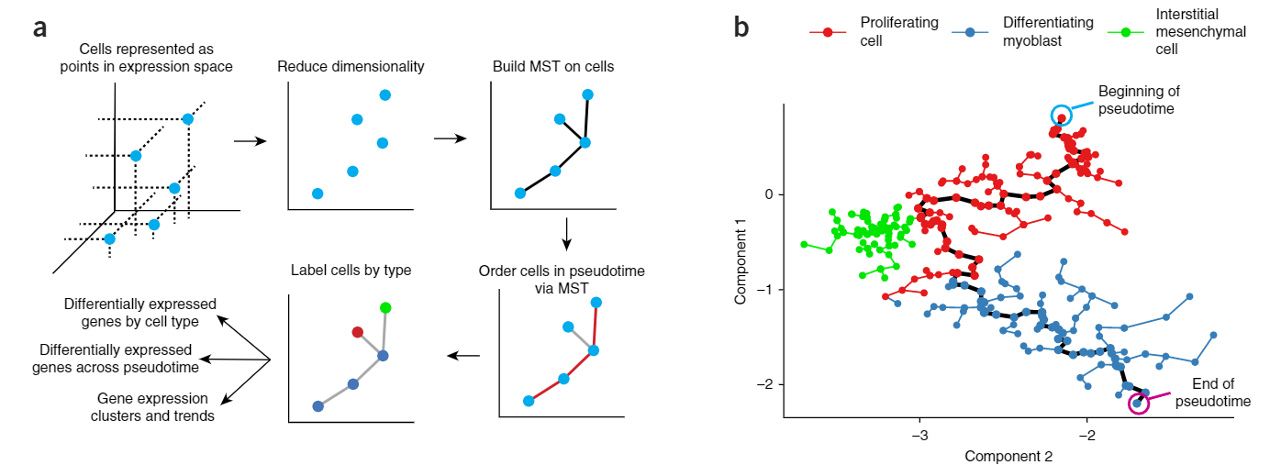
LM0414

Slide 3
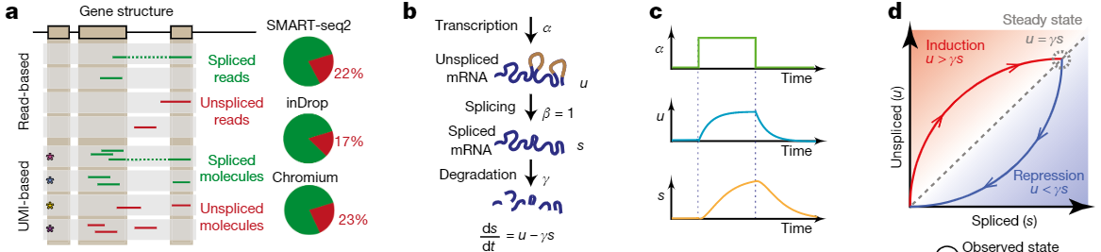


Slide 4
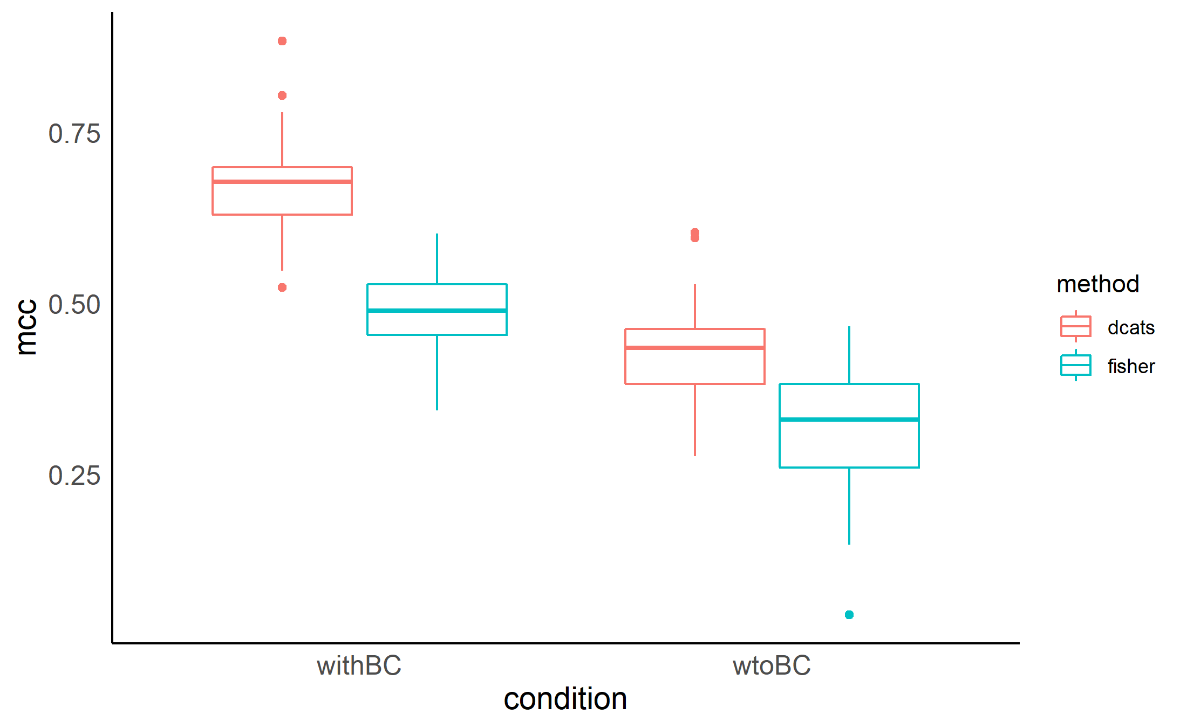
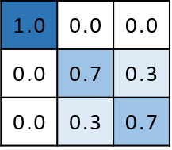

Slide 5
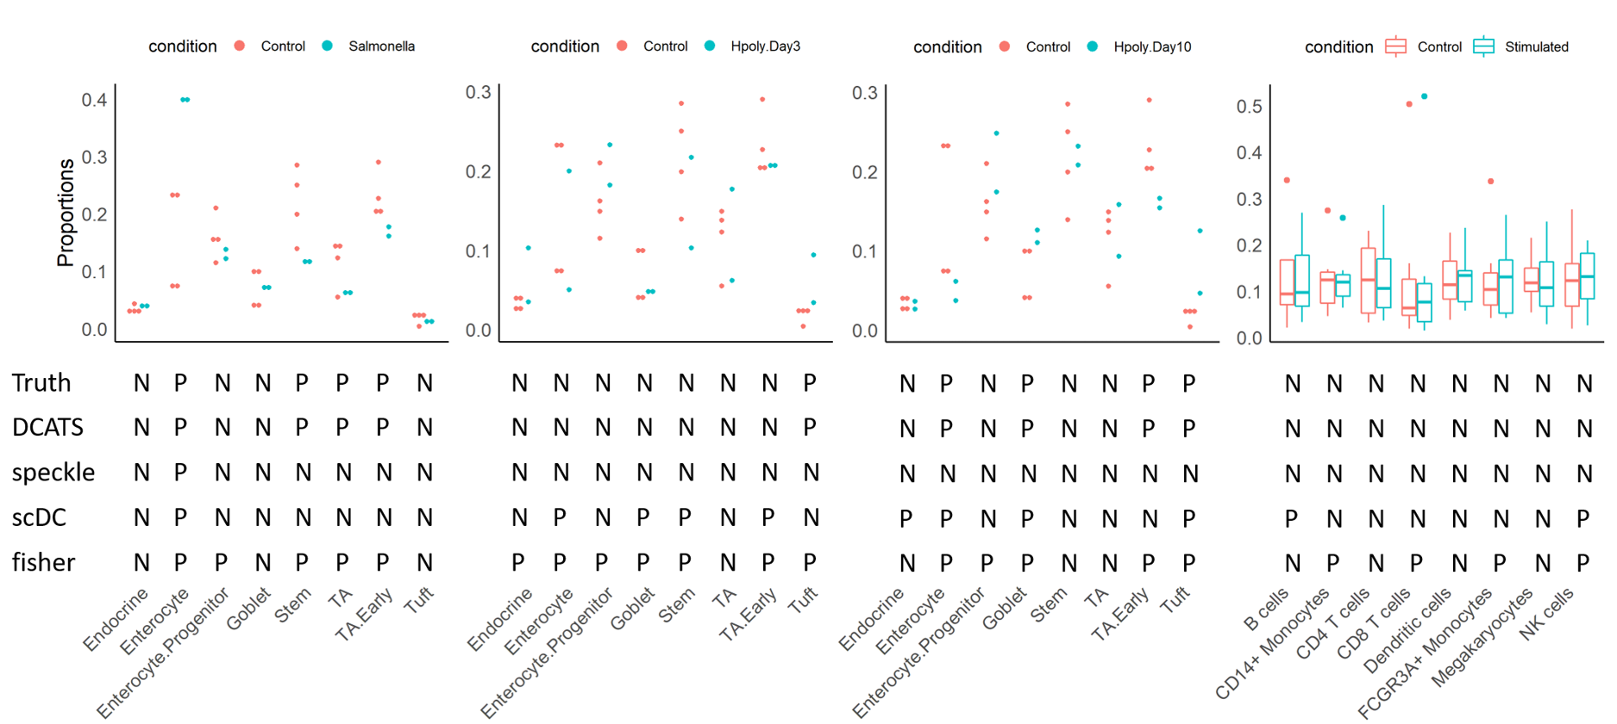
Haber 2017 Kang 2017

Slide 6
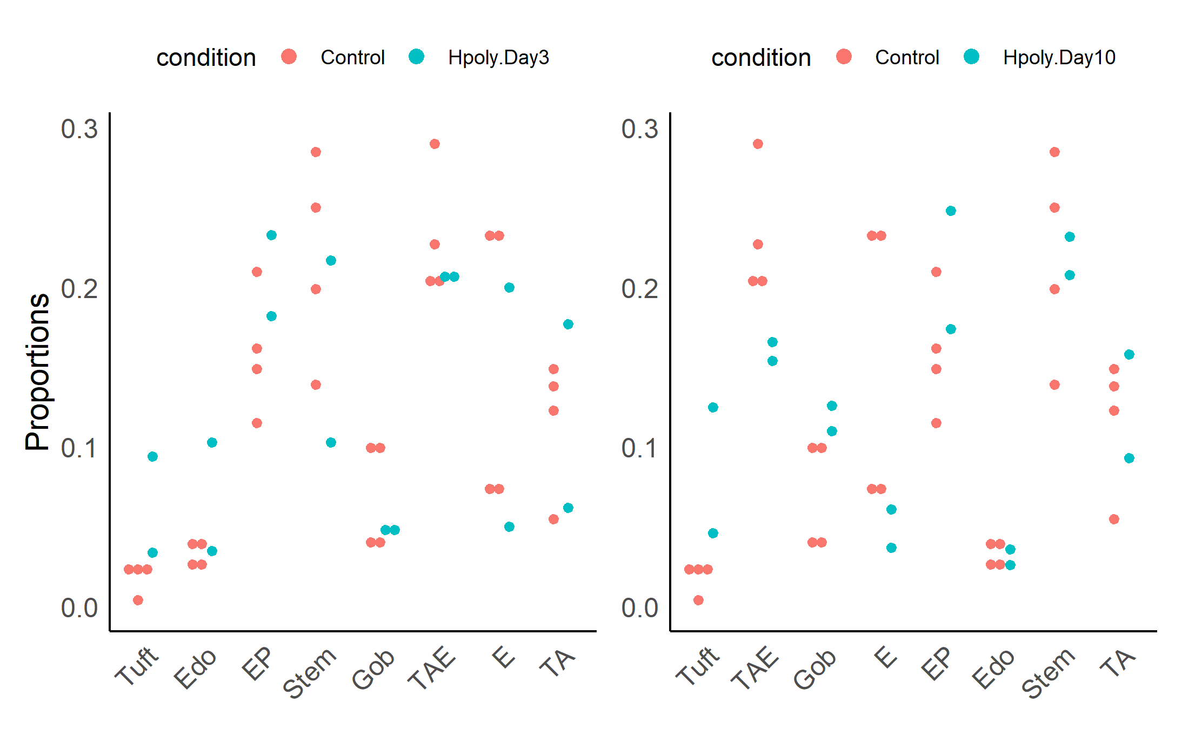
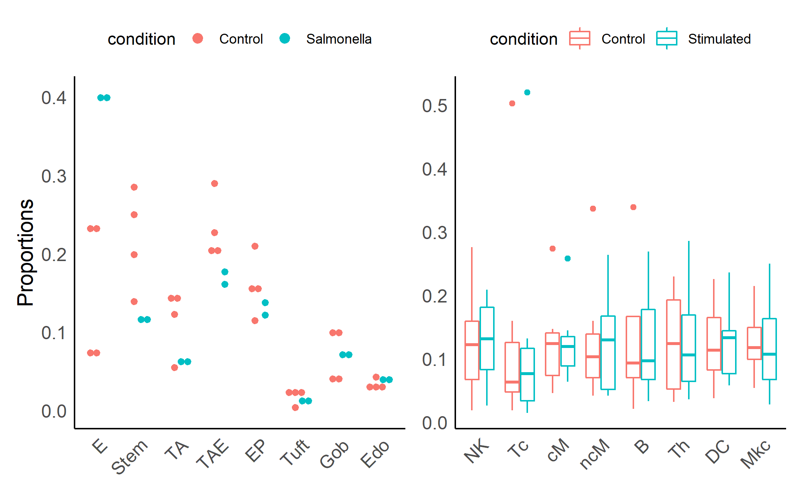
Truth | P | P | P | P | N | N | N | N
DCATS | P | P | P | P | N | N | N | N
speckle | P | N | N | N | N | N | N | N
scDC | P | N | N | N | N | N | N | N
fisher | P | P | P | P | P | N | N | N
P | N | N | N | N | N | N | N
P | N | N | N | N | N | N | N
N | N | N | N | N | N | N | N
N | N | N | P | P | P | P | N
P | P | P | P | P | P | P | N
P | P | P | P | N | N | N | N
P | P | P | P | N | N | N | N
N | N | N | N | N | N | N | N
P | N | P | P | N | P | N | N
P | P | P | P | P | N | N | N
N | N | N | N | N | N | N | N
N | N | N | N | N | N | N | N
N | N | N | N | N | N | N | N
P | N | N | N | P | N | N | N
P | P | P | P | N | N | N | N

Slide 7
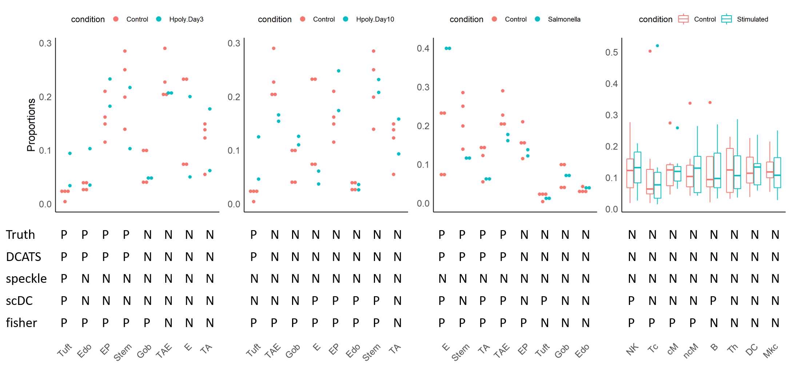
Haber 2017 Kang 2017

Slide 8
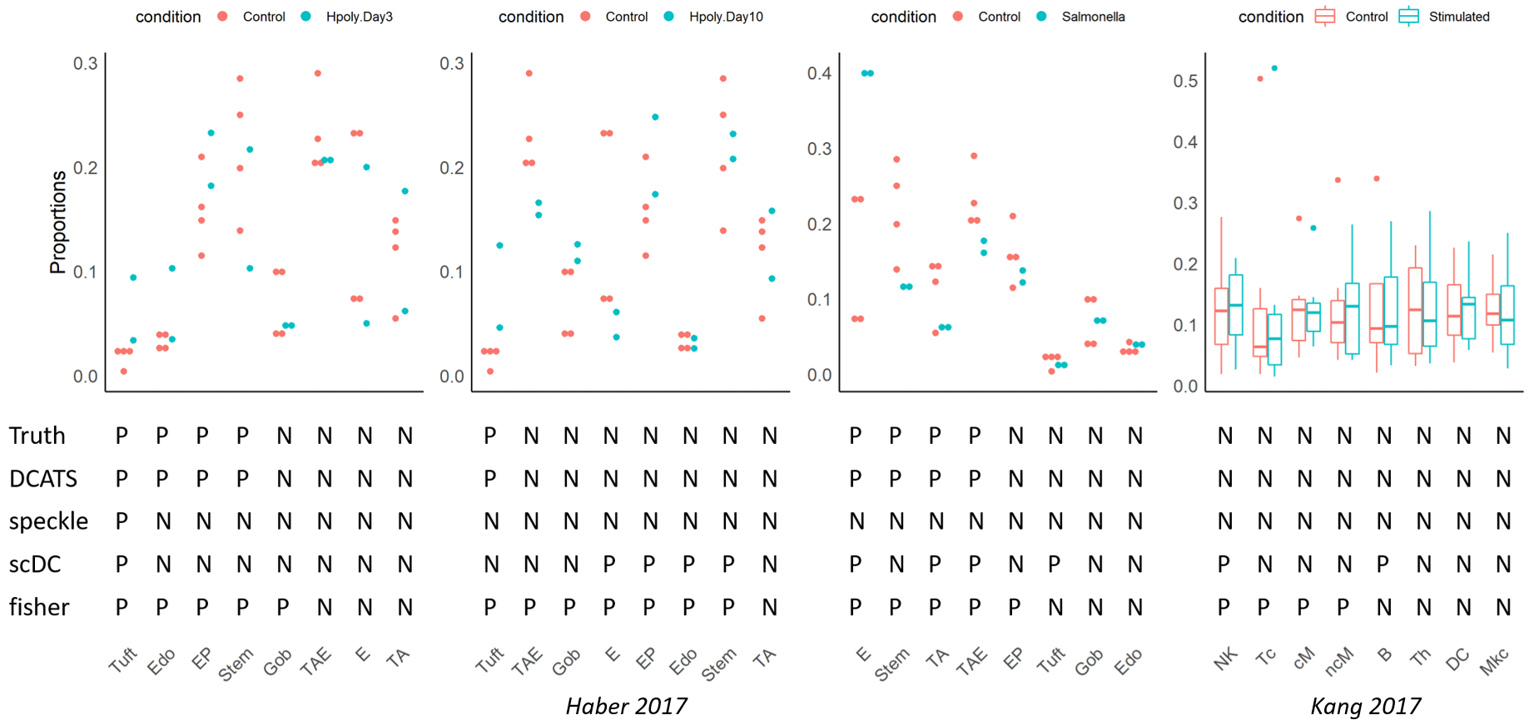

Slide 9
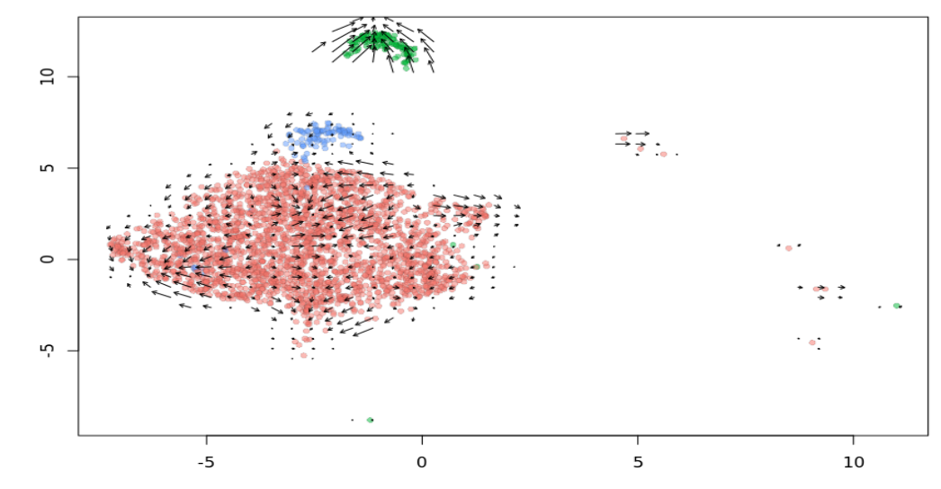
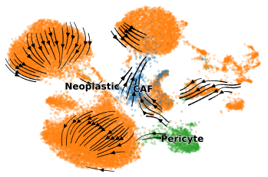
Pericyte
CAF
Neoplastic

Slide 10
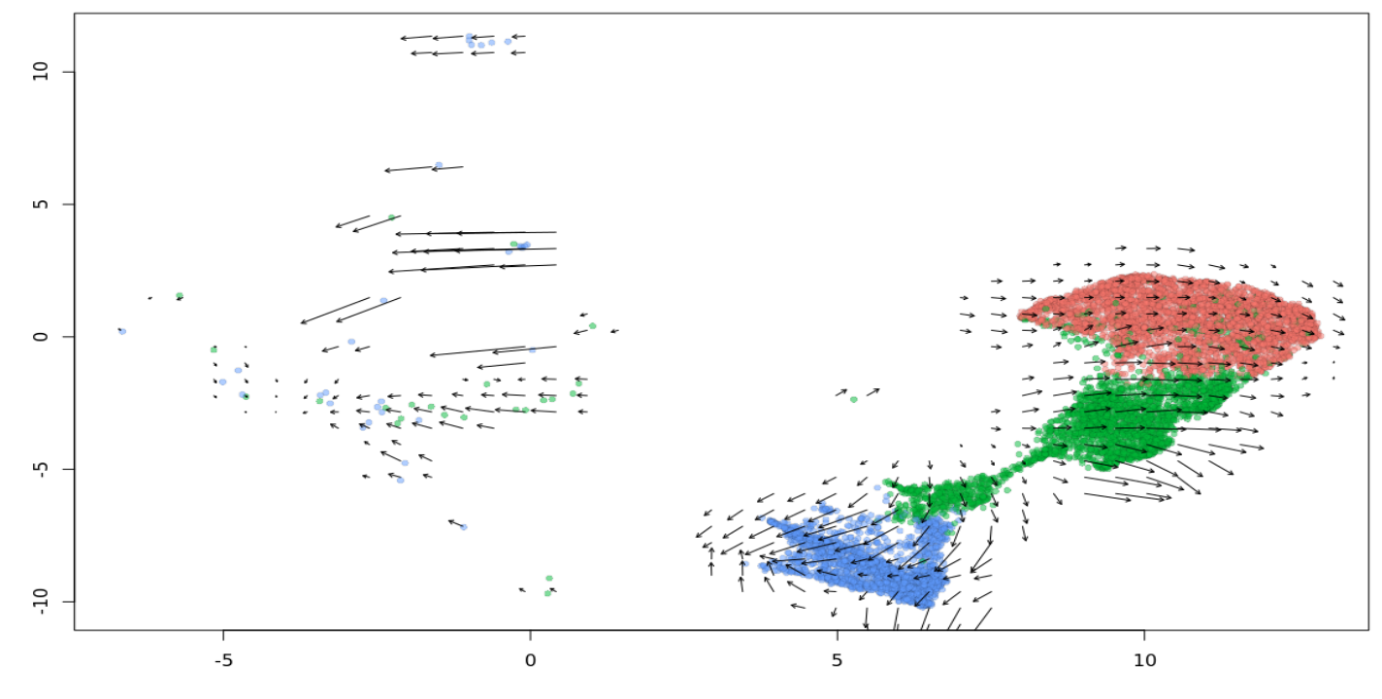
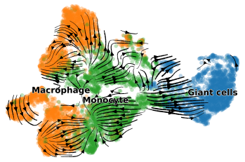
Macrophage
Monocyte
Gaint cells

Slide 11
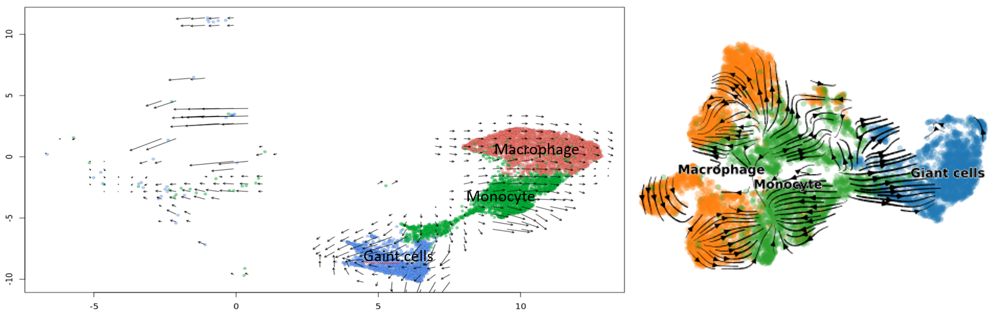

Slide 12
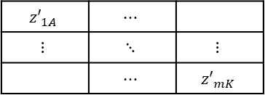
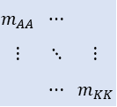
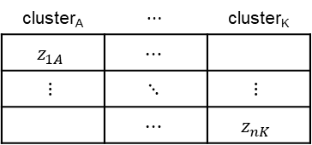
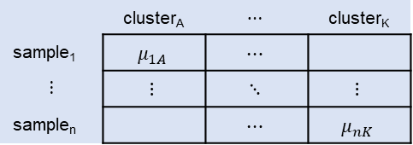
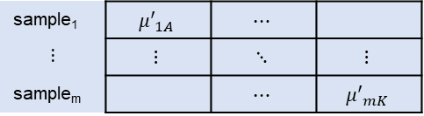
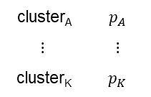
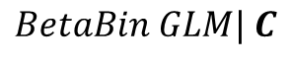
DCATS supplementary
Condition1
Confusion Matrix
Latent True Matrix
Result
 | cluster_{A} | $$⋯$$ | cluster_{K}
sample₁ | $$μ_{1A}$$ | $$⋯$$
$$⋮$$ | $$⋮$$ | $$⋱$$ | $$⋮$$
sample_{n} |  | $$⋯$$ | $$μ_{nK}$$
$$m_{AA}$$ | $$⋯$$
$$⋮$$ | $$⋱$$ | $$⋮$$
 | $$⋯$$ | $$m_{KK}$$
cluster_{A} | $$⋯$$ | cluster_{K}
$$z_{1A}$$ | $$⋯$$
$$⋮$$ | $$⋱$$ | $$⋮$$
 | $$⋯$$ | $$z_{nK}$$
$$BetaBin GLM| C$$
cluster_{A} | $$p_{A}$$
$$⋮$$ | $$⋮$$
cluster_{K} | $$p_{K}$$
Condition2
sample₁ | $${μ′}_{1A}$$ | $$⋯$$
$$⋮$$ | $$⋮$$ | $$⋱$$ | $$⋮$$
sample_{m} |  | $$⋯$$ | $${μ′}_{mK}$$
$${z′}_{1A}$$ | $$⋯$$
$$⋮$$ | $$⋱$$ | $$⋮$$
 | $$⋯$$ | $${z′}_{mK}$$

Slide 13
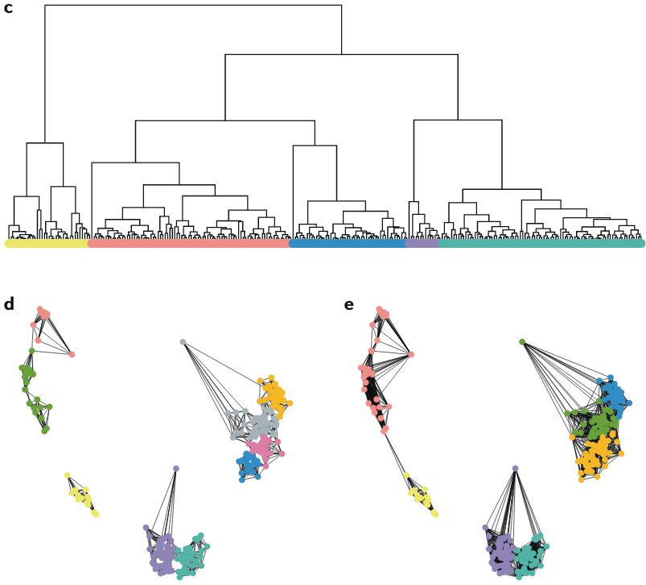
MMPH6140

Slide 14
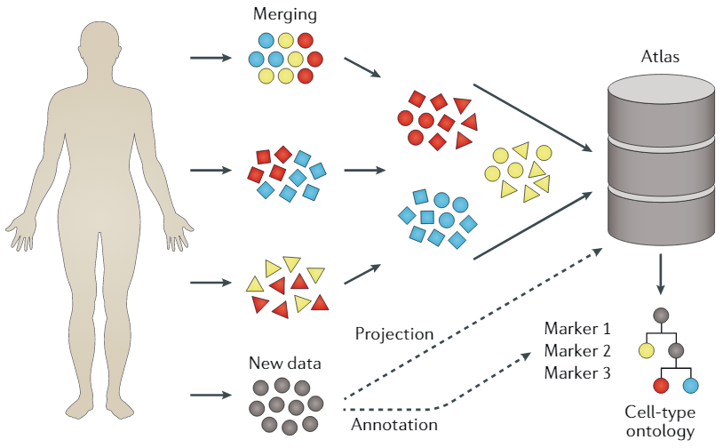

Slide 15
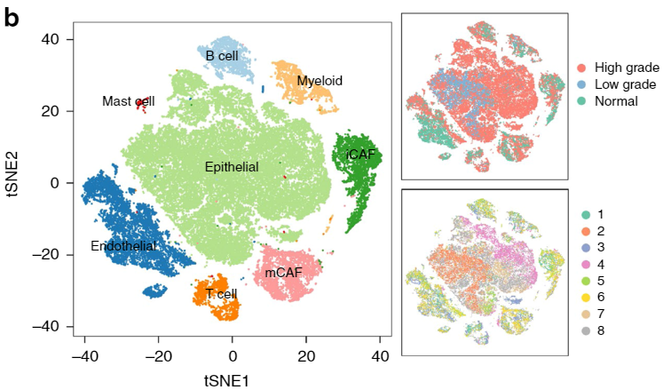

Slide 16
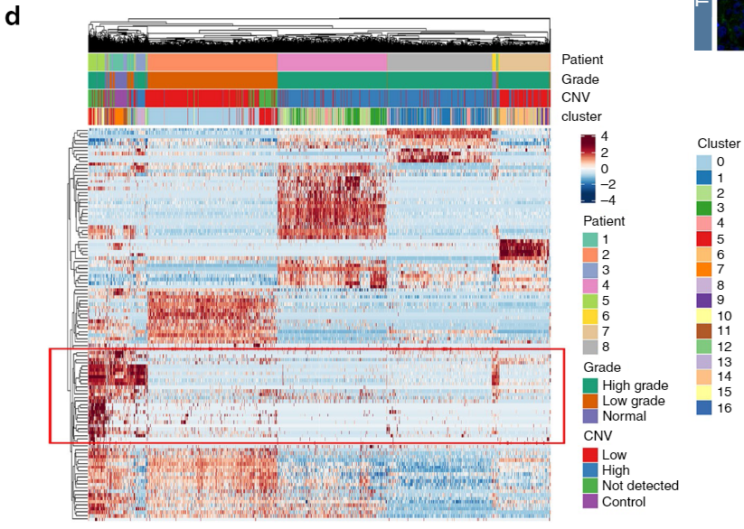
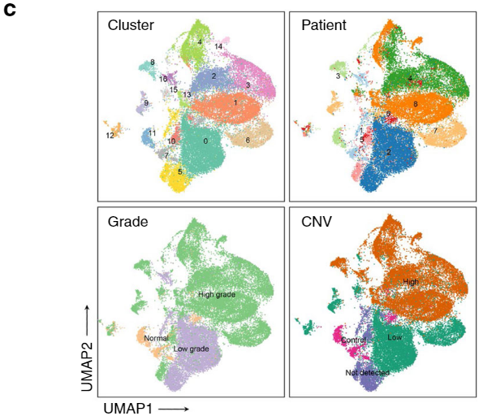


Slide 17
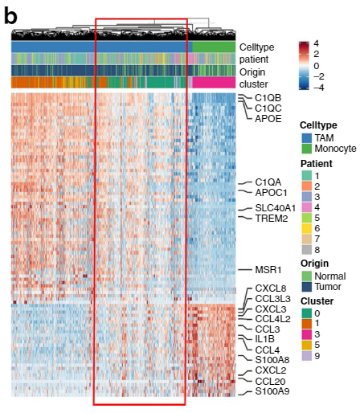
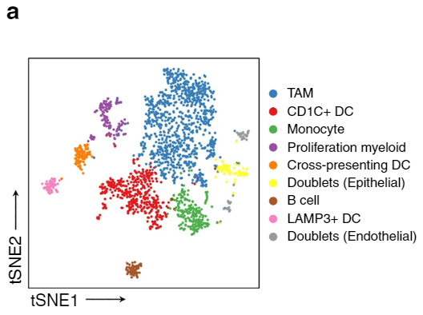
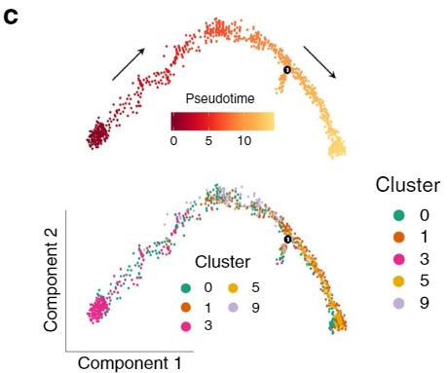

Slide 18
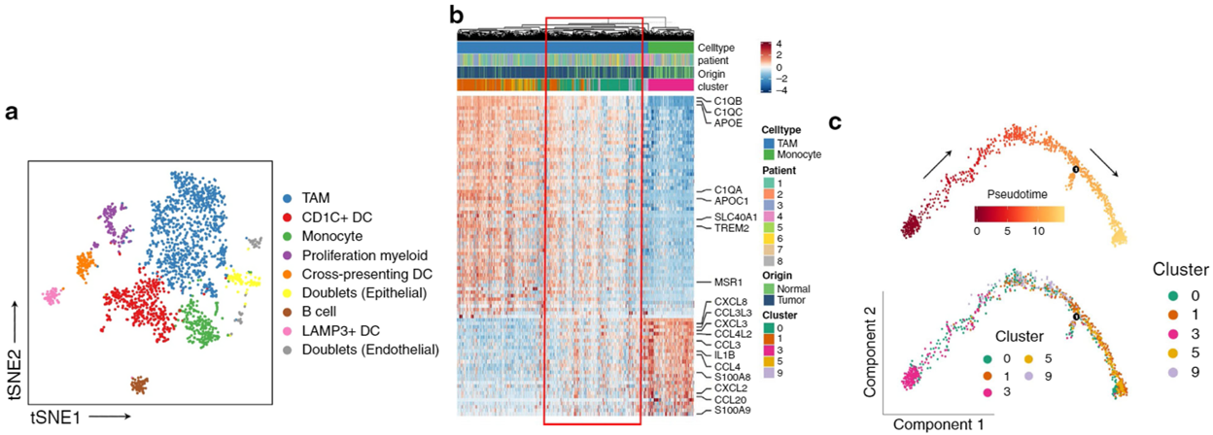

Slide 19
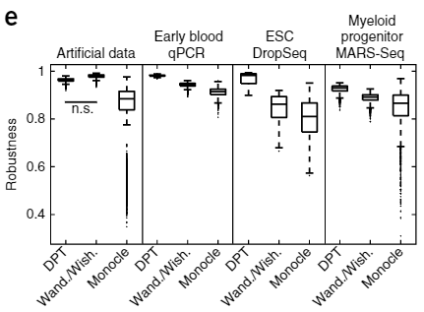
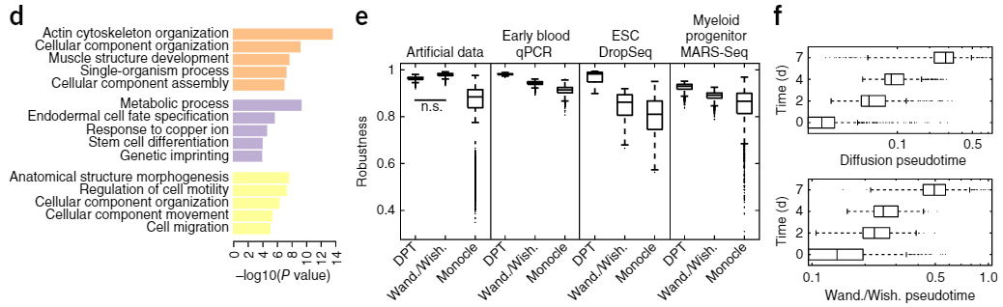
JC0522

Slide 20
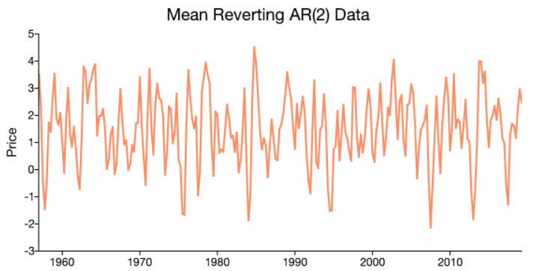
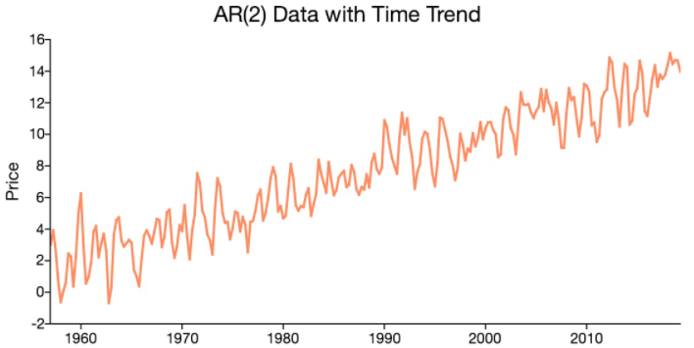
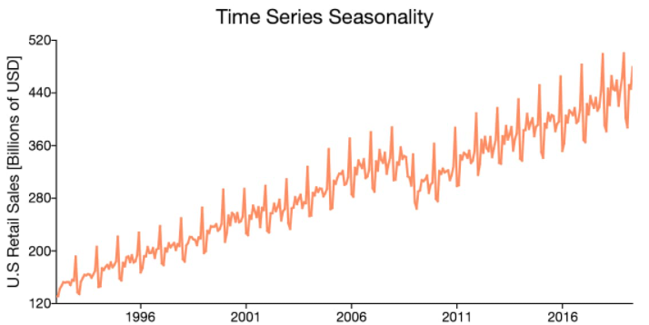
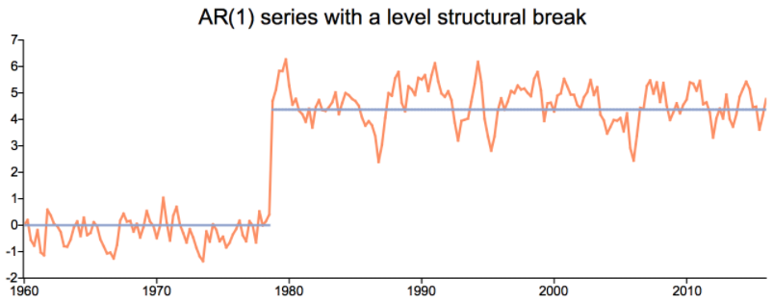

Slide 21
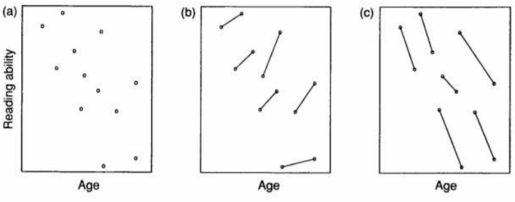

Slide 22
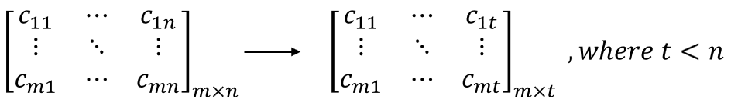
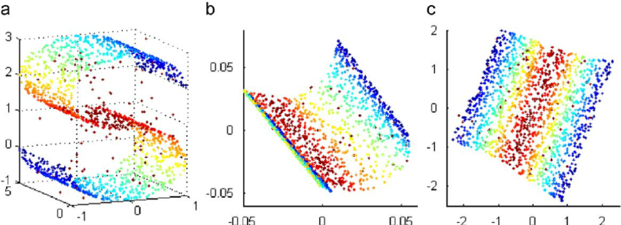
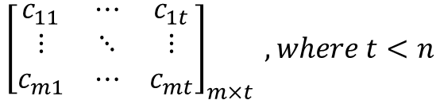
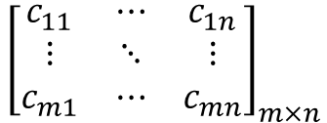
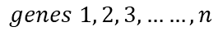
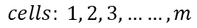
$${\left[\begin{matrix}c_{11} & ⋯ & c_{1n} \\ ⋮ & ⋱ & ⋮ \\ c_{m1} & ⋯ & c_{mn}\end{matrix}\right]}_{m×n}$$
$${\left[\begin{matrix}c_{11} & ⋯ & c_{1t} \\ ⋮ & ⋱ & ⋮ \\ c_{m1} & ⋯ & c_{mt}\end{matrix}\right]}_{m×t} , where t<n$$
$$cells: 1, 2, 3, ……, m$$
$$genes 1, 2, 3, ……, n$$
$$principle components\left(PCs\right) 1, 2, 3, ……, t$$

Slide 23
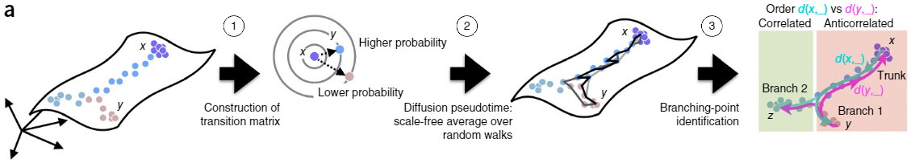
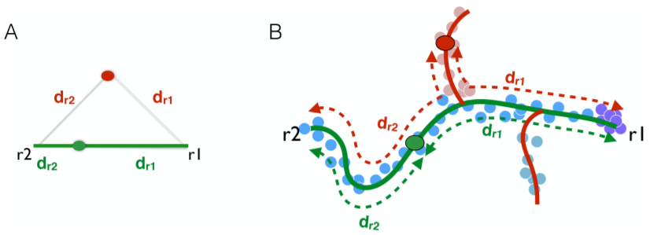

Slide 24
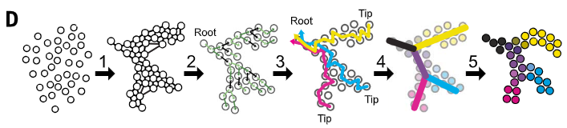
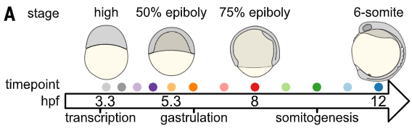

Slide 25
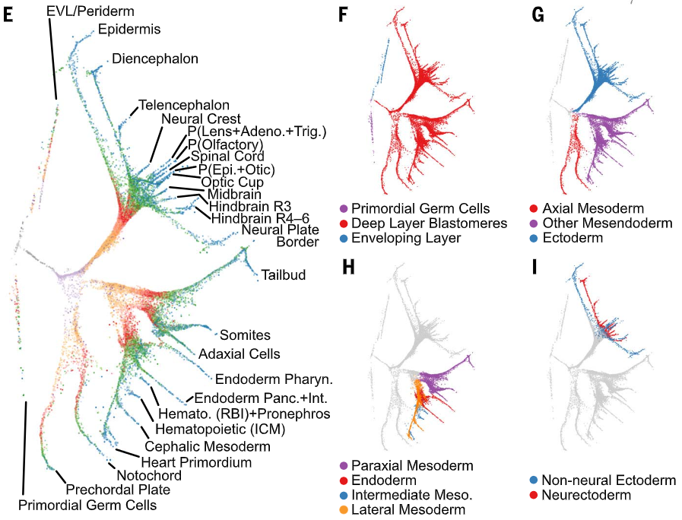

Slide 26
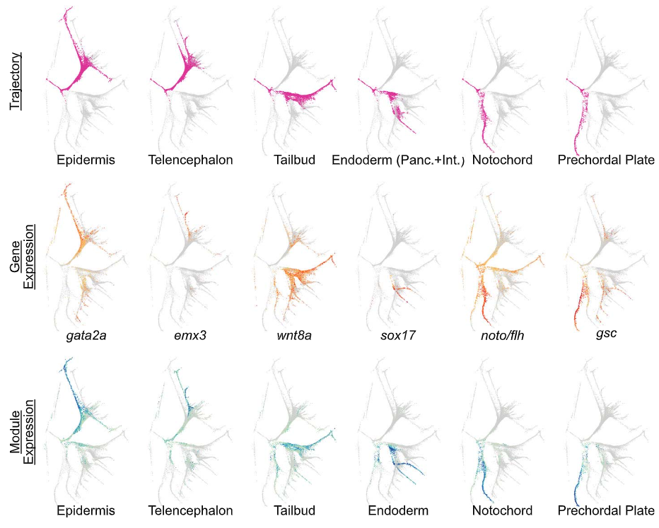
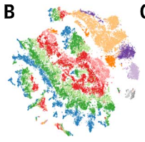


Slide 27

B
A
B’
C

Slide 28


LM0610

Slide 29


